Slide 1
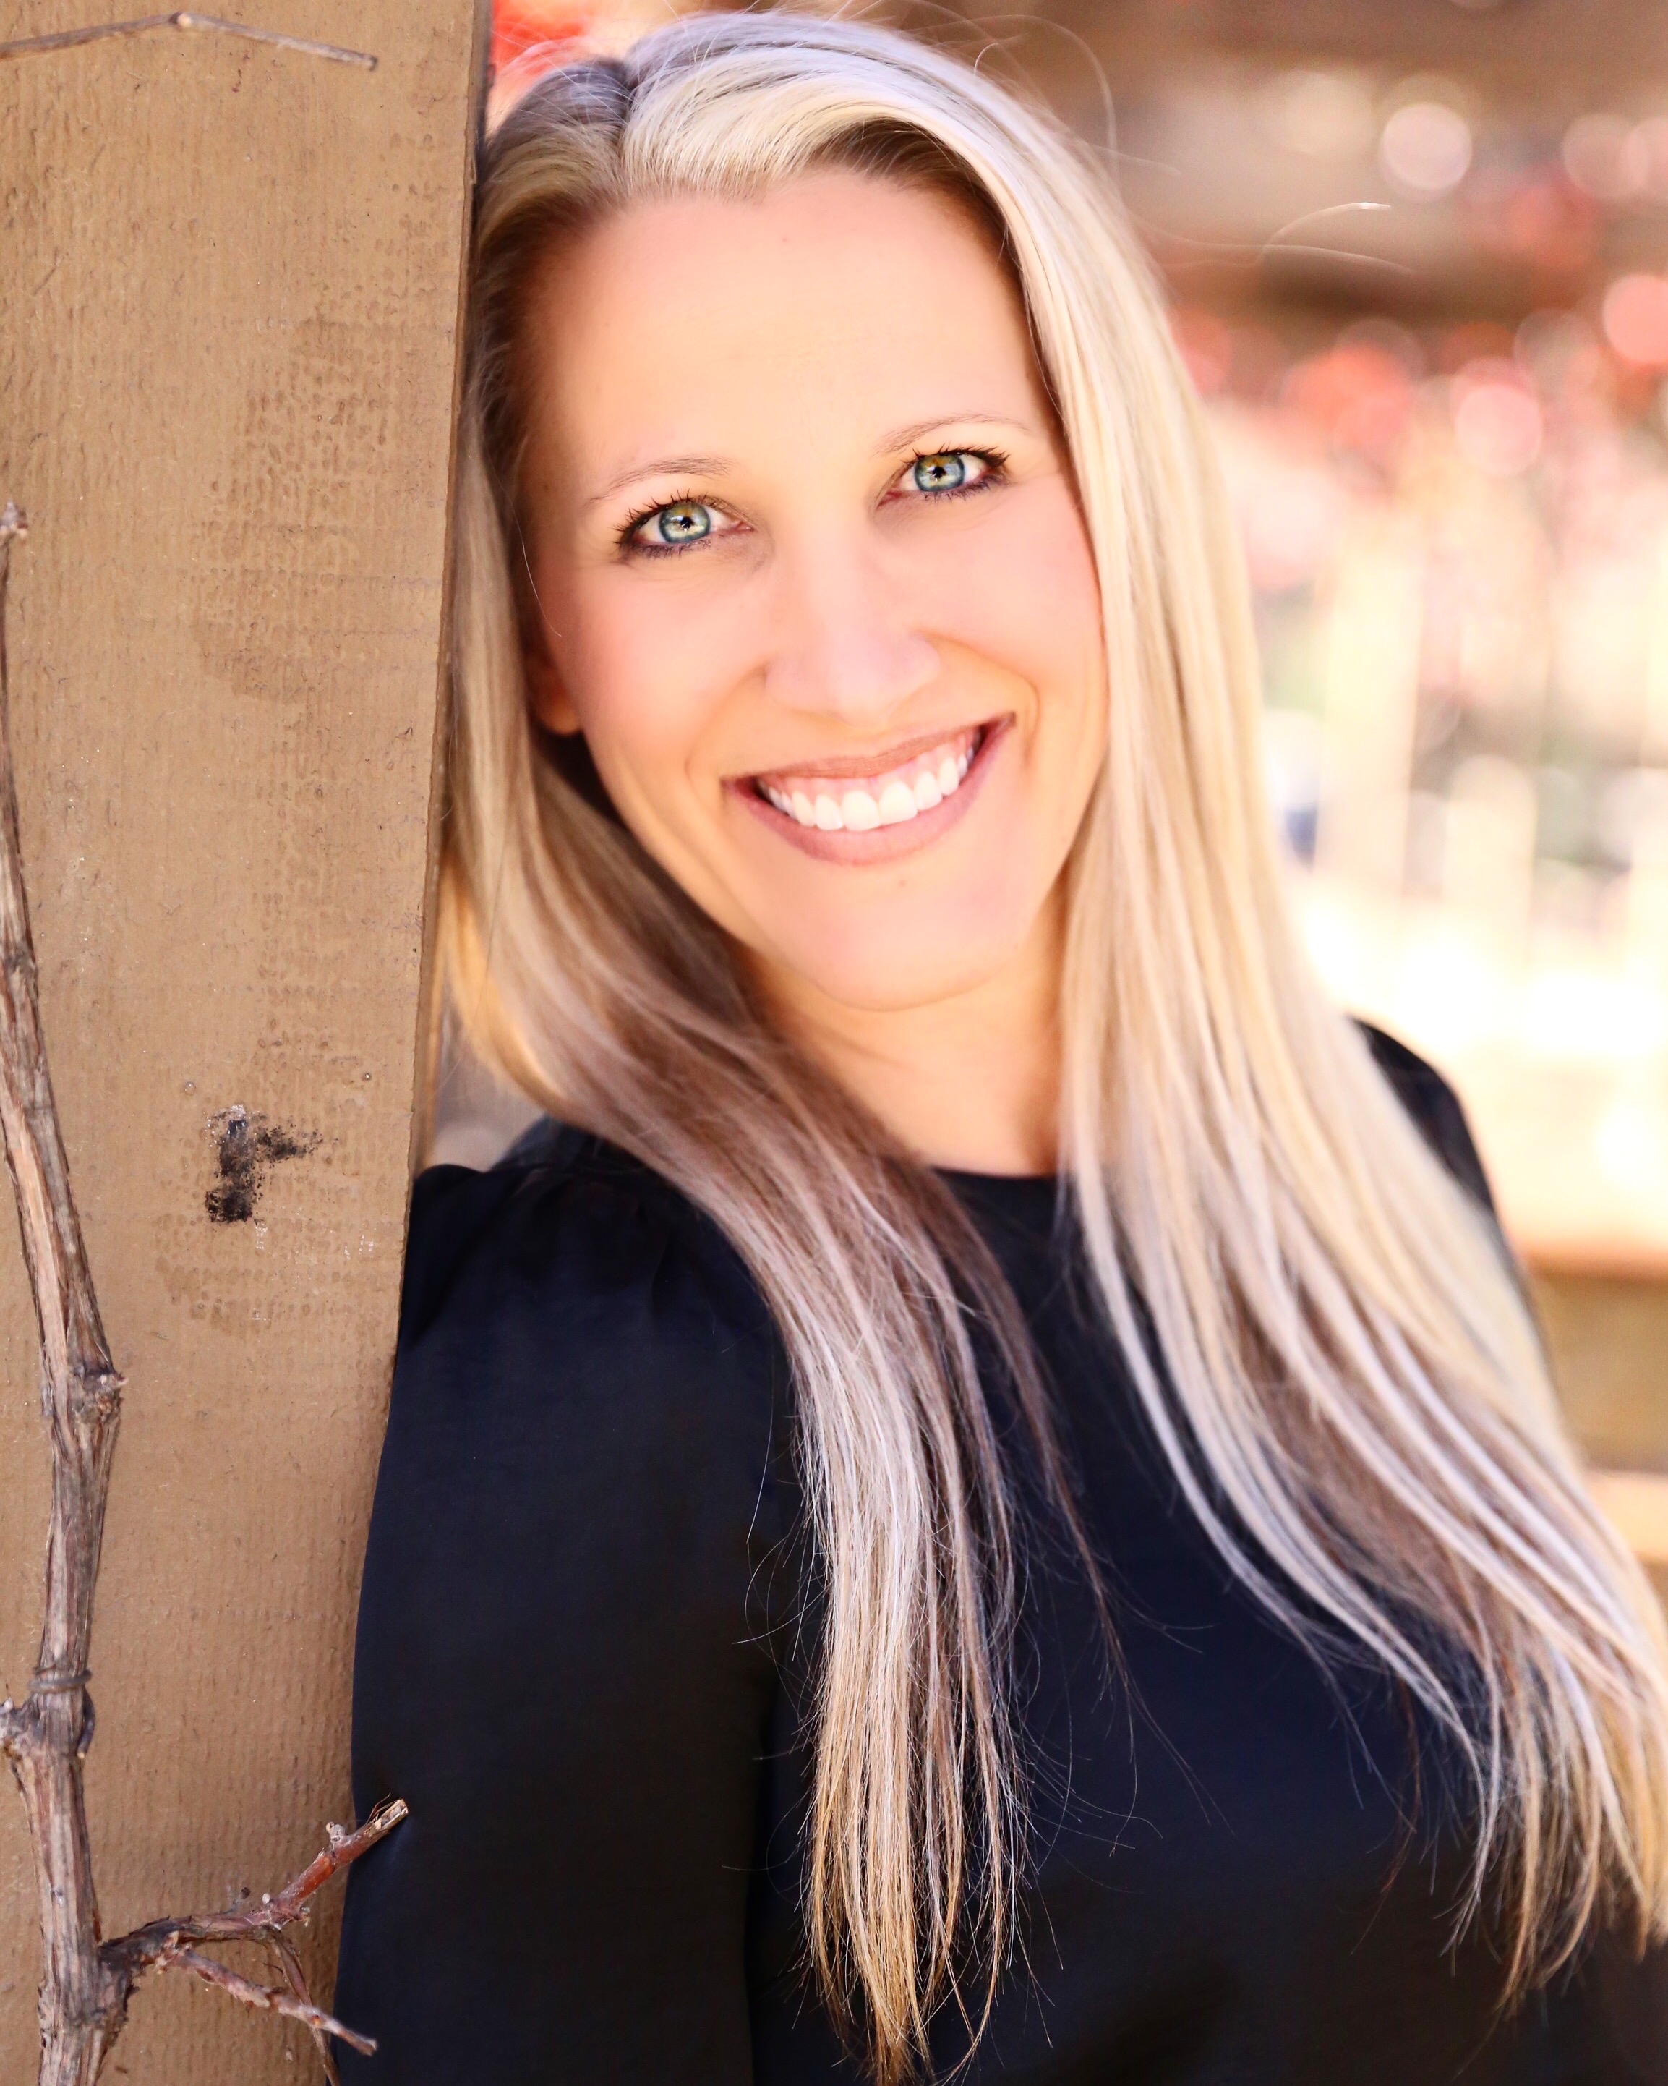
DR. KIM VAN DUSEN
Parenting + Lifestyle Blogger/Influencer
55k+
515+
460+
90+
Dr. Kim is the owner/founder of THE PARENTOLOGIST w/ DR. KIM, a parenting resource for moms and moms-to-be about everything parenting with a therapeutic twist! She is a mom of two, a licensed marriage and family therapist, a registered play therapist, a university professor, event planner, and public speaker! She is a TODAY Show Parenting Team Contributor and recently has been an expert guest on KFMB News 8 Morning Extra on the CW San Diego.

Slide 2
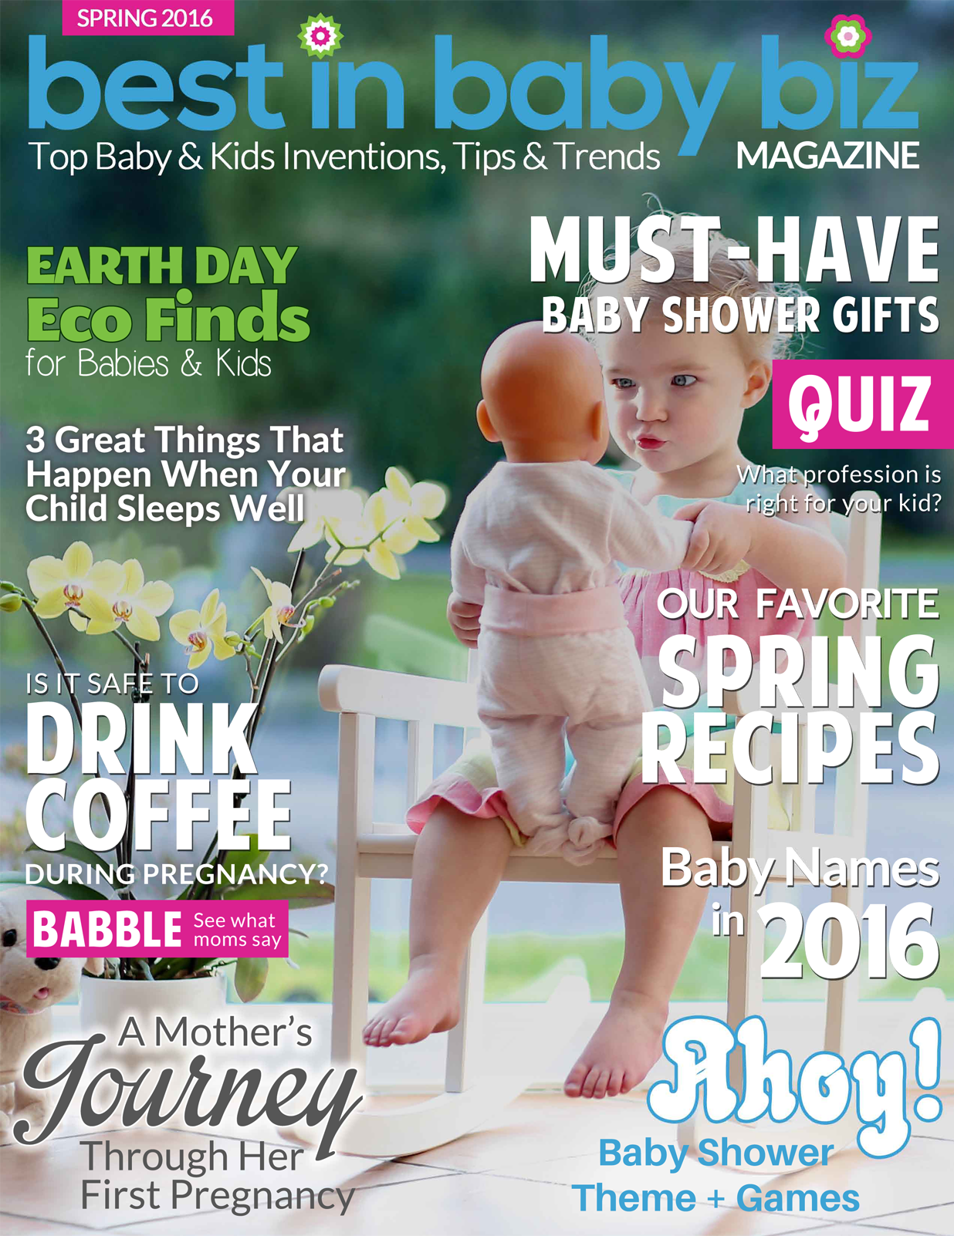
As Seen On
PUBLIC SPEAKING
Dr. Kim has 20 years of public speaking experience
San Diego County of Education
AEYC conference
The APA Conference
The California APT San Diego Chapter Play Therapy
Elementary School PBIS Trainings
Clinician Trainings
University Professor
You Tube Parenting Talk Show Launching January 2018
BRAND PARTNERS
DEMOGRAPHIC
W25-34
91% WOMEN/MOMS
DOMESTIC & INTERNATIONAL FOLLOWING
AUDIENCE REACH
1000+ MONTHLY BLOG READERS
100+ BLOG SUBSCRIBERS
1000+ LIKES ON INSTAGRAM
CONTACT ME
WWW.THEPARENTOLOGIST.COM
@THEPARENTOLOGIST
THEPARENTOLOGIST@GMAIL.COM

